Slide 1
Blood Donor Return Dynamics: A Microsimulation Model
EPIB 676: Final Project Presentation
Huzbah Jagirdar

Slide 2

Decision Problem
Most medical care depends on a steady blood supply to meet urgent care needs in healthcare facilities.
Blood collection sites often issue a haemoglobin deferral to donors when tested for low haemoglobin levels.
Making an informed decision about potential changes to inter-donation interval and deferral policies impacts donor return.
This highlights the importance of blood collection sites evaluating their deferral policies and tailoring their inter-donation intervals (IDIs) to encourage donors to return promptly once eligible.

Slide 3
Alternatives
Standard 56-day (8 weeks) Interval for both men and women
8 weeks for men and 12 weeks for women
12 weeks for both men and women

Slide 4
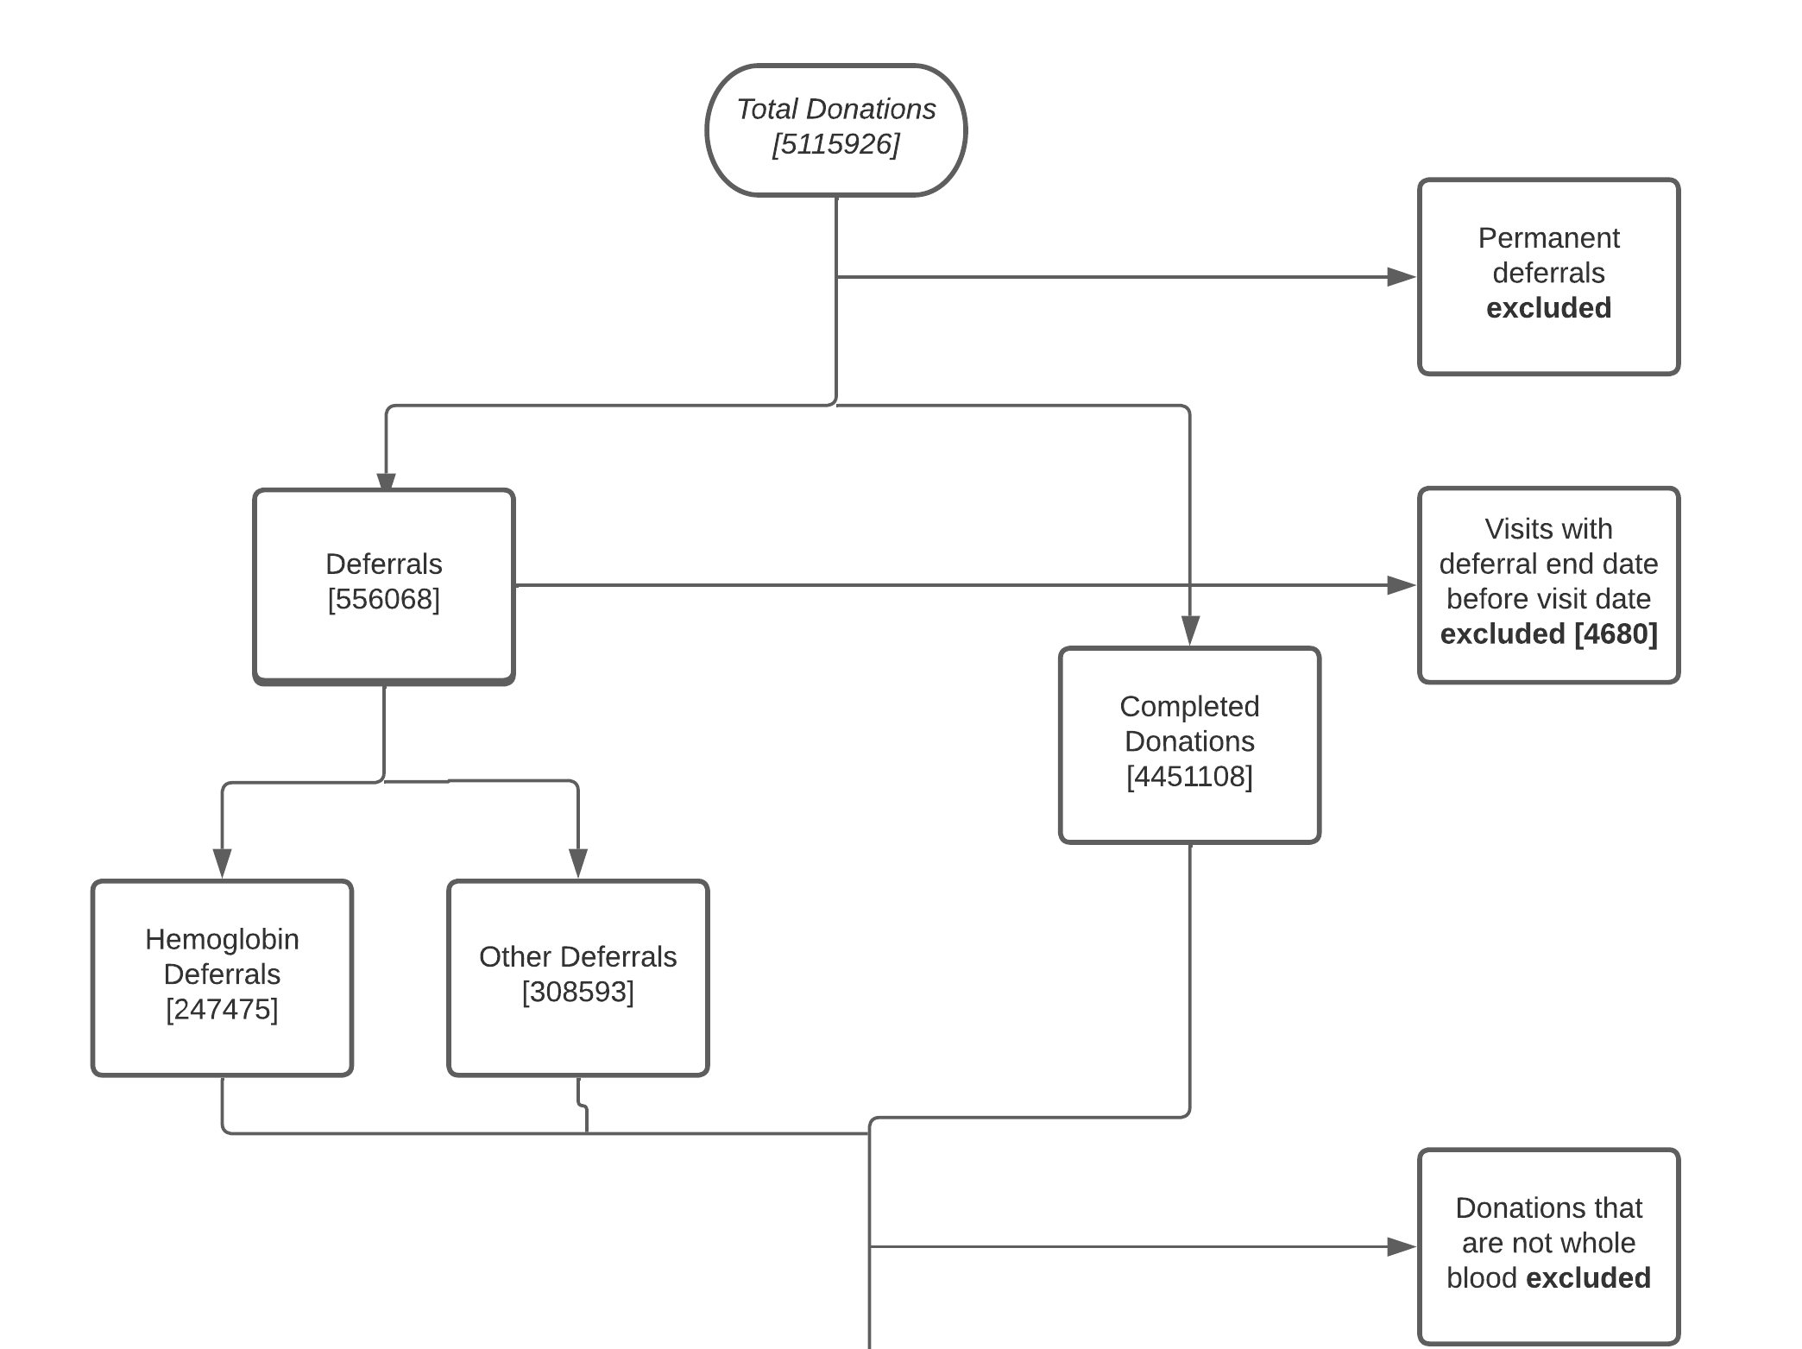
Data
South Africa National Blood Services (SANBS)

Slide 5
Method: Analytical Framework
Comparative Effectiveness:
Count of completed donations and haemoglobin deferrals
Profit Maximization:
Estimated profit= Revenue from the completed donation – the (cost of a haemoglobin deferral + completed donation)
This model will have only Operational Outcomes

Slide 6
Method
Model is parameterised using SANBS data
Only whole blood visits included
About 85% completed donations and 15% deferrals
Time Horizon: 2017-2022 [To construct donor history:2015-2022]
Predictions from CPH model were used to estimate the time to return and predictions from logistic regression were used to estimate probability of deferral

Slide 7
Method: A Discrete Event Microsimulation Model
Penalised Cox Proportional Hazards
Logistic Regression
Age+Sex+Fixed/Mobile+Outcome_type…and other covariates
Follow-up Time/ Time-to-Return
HGB Deferral
Simulated 10,000 donors sampled from dataset

Slide 8
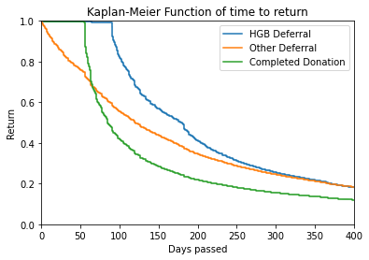
Results

Slide 9
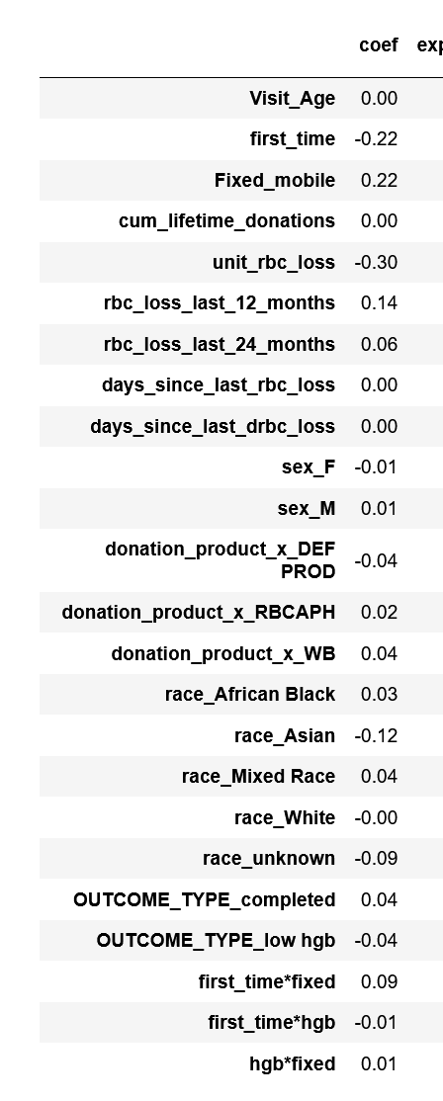
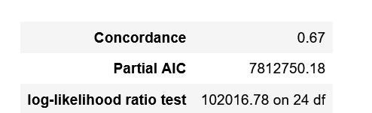
Results-Training the Penalized Cox Model

Slide 10
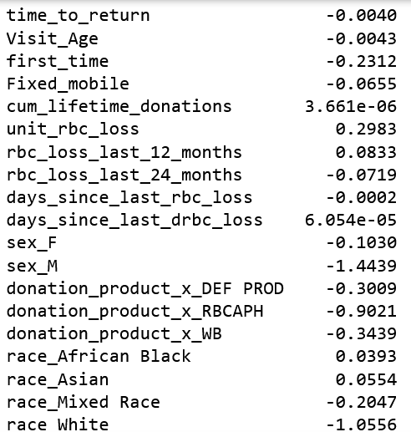
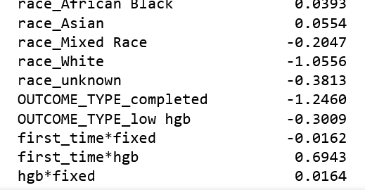
Results – Training the Logistic Regression

Slide 11
Results – Microsimulation Model
Cost of deferral= R211.83
Cost of successful donation= R609.28
Revenue from successful donation= R2291.30
 | Standard: 8 weeks for both | 12 weeks for men, 8 weeks for women | 12 weeks for both
Deferrals | 6643 | 8893 | 9454
Successful Donations | 3357 | 1107 | 546
Deferral Rate | 33.57% | 11.07% | 5.46%
Estimated Profit | 10462545.55 | 14723708.05 | 15785968.80

Slide 12
In the Future
Refine the penalised cox model, and use a different approach to predict a haemoglobin deferral (non-binary outcome)
1
Add the aspect of donating at a fixed site or mobile drive in the simulation model
2
Include analysis performed on USA (Vitalant) data – compare dynamics between the two countries.
3

